Slide 1




Week-7 (Discussion)
9th September, 2024
Introduction to Machine Learning
Prof. Balaraman Ravindran
Professor and Head of the Department
Department of Data Science and Artificial Intelligence
IIT Madras
Ayan Paul
PMRF Research Scholar
IIT Kharagpur

Slide 2
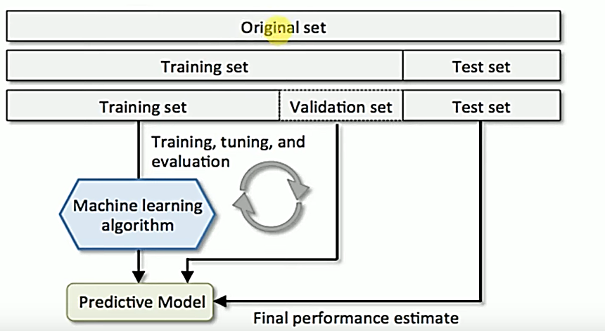
Train, Validation and Test Set
Training Dataset: The sample of data used to fit the model.
Validation Dataset: The sample of data used to provide an unbiased evaluation of a model fit on the training dataset while tuning model hyperparameters.
Test Dataset: The sample of data used to provide an unbiased evaluation of a final model fit on the training dataset.

Slide 3
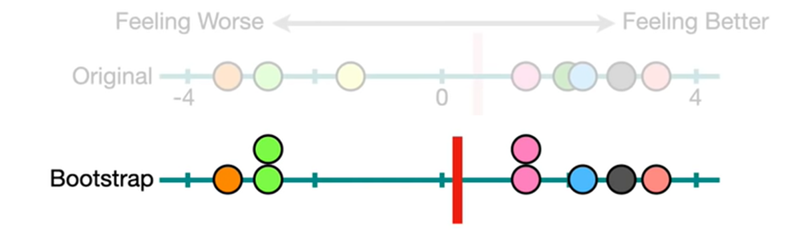
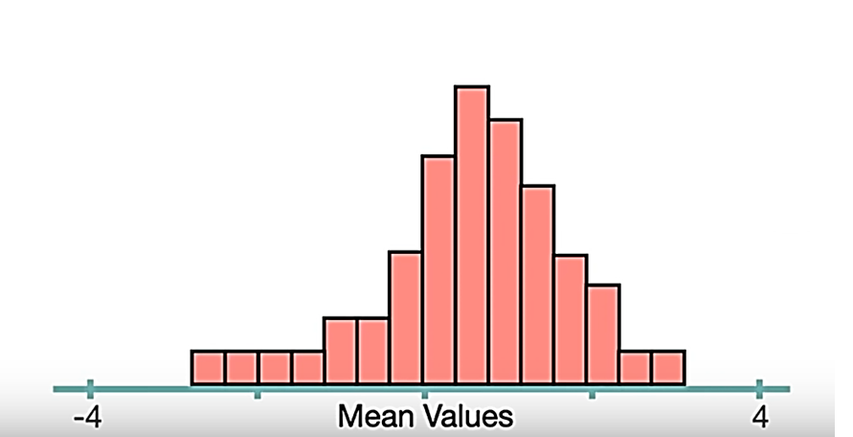
Bootstrapping
Bootstrapping is a resampling technique that includes sampling the original dataset with replacement and generating multiple new datasets of the same size as the original, called bootstrap samples.
Each bootstrap sample is used to calculate the desired statistic, such as the mean or standard deviation.
This process is repeated multiple times, and the resulting values are used to construct a probability distribution for the desired statistic.

Slide 4
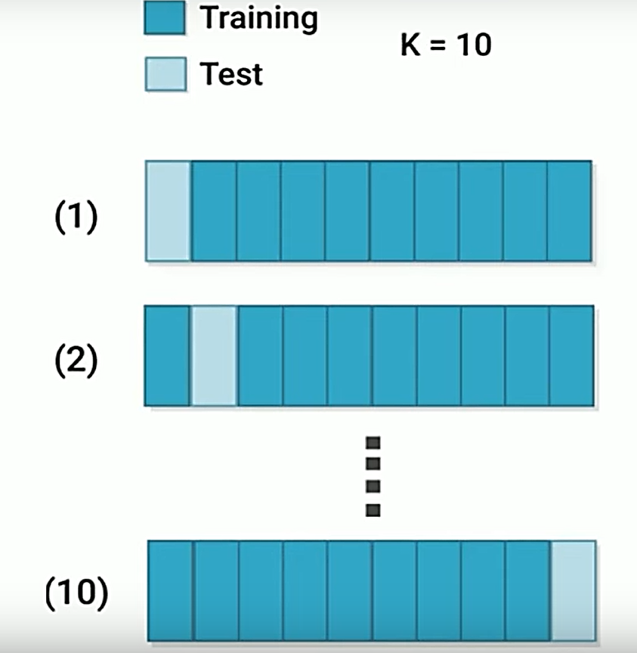
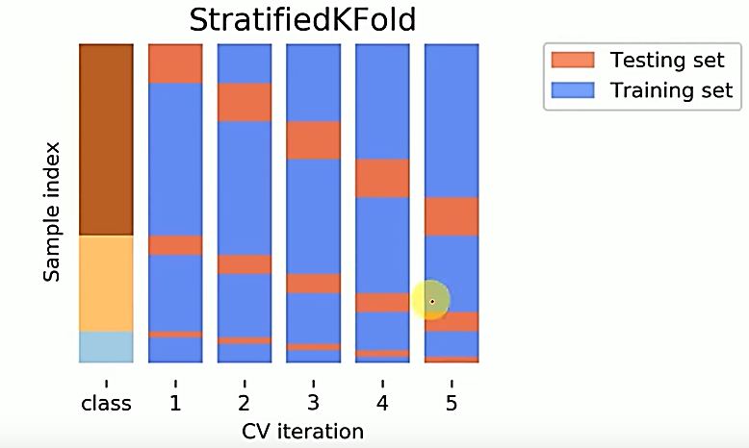
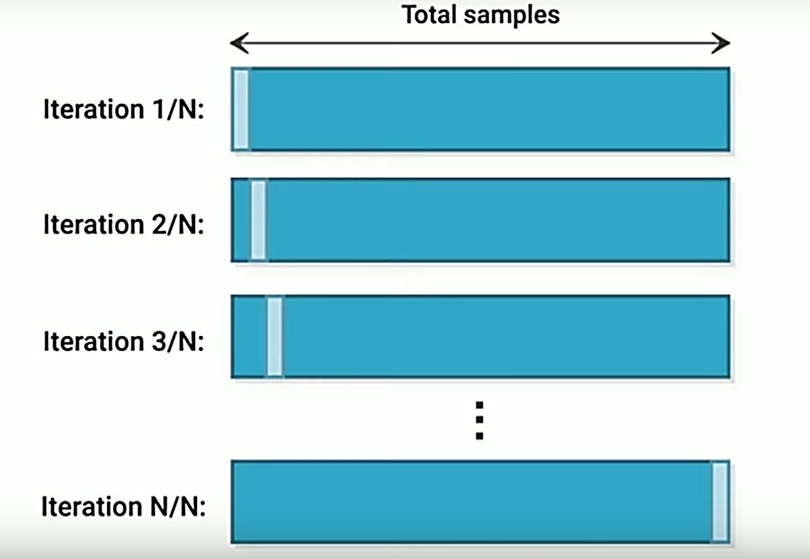
Cross Validation in Machine Learning
The idea of cross validation arises because of problems with train test models. It basically wants to guarantee that evaluation of our model does not depend upon the way we pick the train and test set.
Types
K-fold
Stratified K-fold
Leave-One-Out

Slide 5
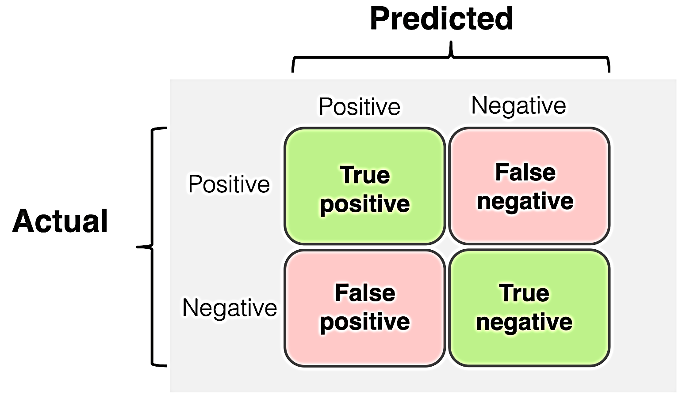
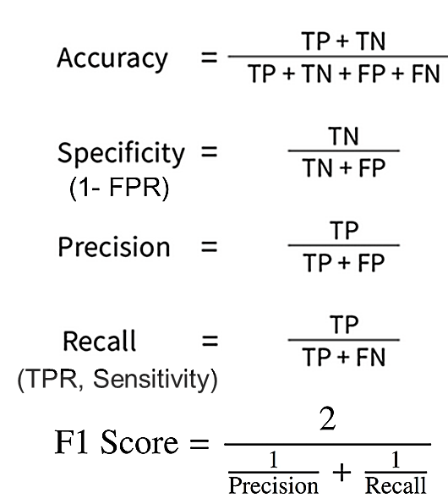
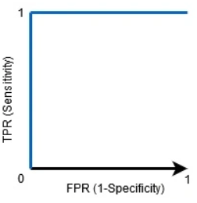
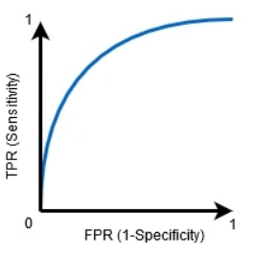
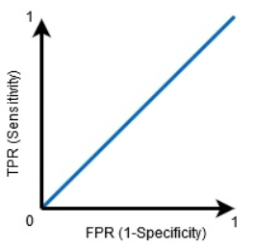
Confusion Matrix
The confusion matrix is a way to visualize how many samples from each label got predicted correctly.
ROC and AUC Curve
The higher the AUC, the better the model’s performance at distinguishing between the positive and negative classes.
The Receiver Operator Characteristic (ROC) curve is an evaluation metric for binary classification problems. It is a curve that plots the TPR against FPR at various threshold values.
The Area Under the Curve (AUC) is the measure of the ability of a binary classifier to distinguish between classes and is used as a summary of the ROC curve.
AUC = 1
0.5<AUC<1
AUC = 0.5

Slide 6
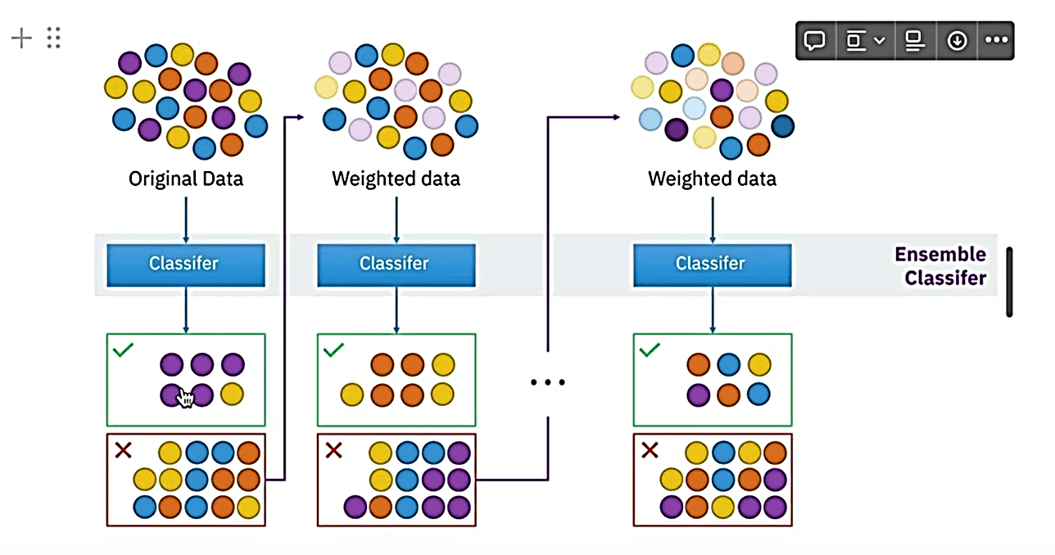
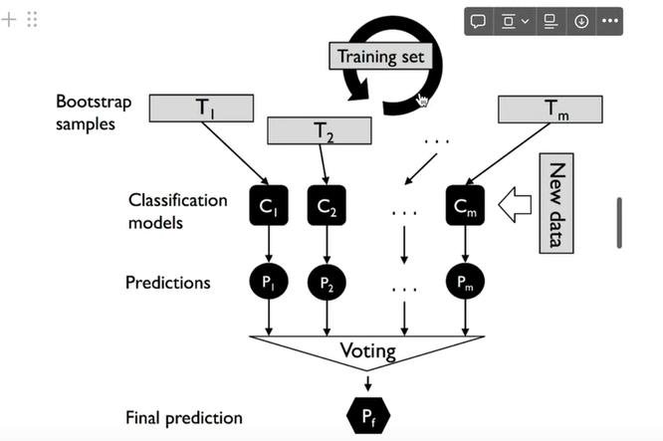
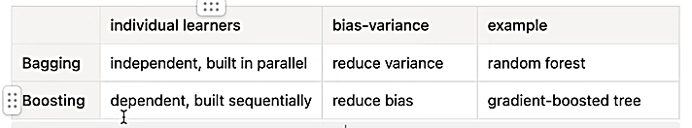
Ensemble Methods
The main idea behind ensemble methods is a group of “week learners” can come together to form a “strong learners”
Types
Bagging
Boosting
Short form for Bootstrap Aggregation. It builds several instances of an estimator on bootstrap samples and then aggregate their individual performance to form a final prediction
Boosting improves the prediction power by training weak learners sequentially, each compensating weakness of the predecessors.

Slide 7
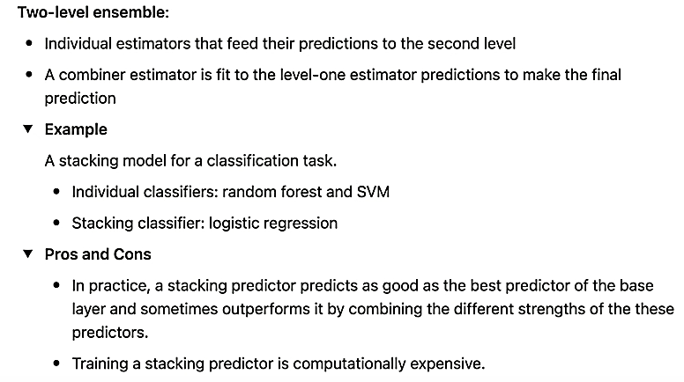
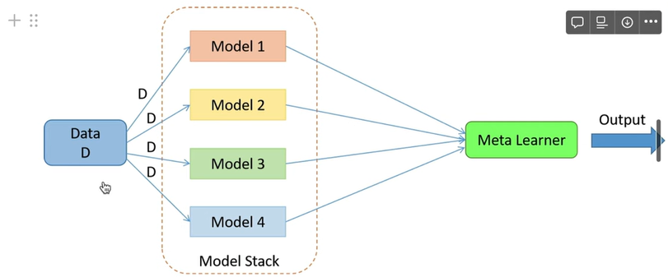
Stacking
Building meta-models that takes the output of base models as input

Slide 8
Topics on which Week 7 Assignment Questions are based
Bootstrapping and Cross Validation
Evaluation Measures and ROC Curve
Ensemble Methods

Slide 9
QUESTION 1
We have a dataset with 1000 samples and 5 classes for classification. What would be the training size for a 20 fold cross validation?
(a) 50
(b) 200
(c) 800
(d) 950
SOLUTION 1
The training size does not depend on the number of classes. 20 fold means that the dataset will be divided equally 20 and 19 of those will be used for training which results in the answer to be 950.
CORRECT ANSWER 1
d)

Slide 10
QUESTION 2
Suppose we have a classification dataset comprising of 2 classes A and B with 100 and 50
samples respectively. Suppose we use stratified sampling to split the data into train and test
sets. Which of the following train-test splits would be appropriate?
a) Train- {A : 80 samples,B : 30 samples}, Test- {A : 20 samples,B : 20 samples}
b) Train- {A : 20 samples,B : 20 samples}, Test- {A : 80 samples,B : 30 samples}
c) Train- {A : 80 samples,B : 40 samples}, Test- {A : 20 samples,B : 10 samples}
d) Train- {A : 20 samples,B : 10 samples}, Test- {A : 80 samples,B : 40 samples}
SOLUTION 2
In stratified sampling, the train and test sets have the same class proportions as the original dataset. Also, the train set is generally chosen to be larger than the test set.
Options (c) and (d) preserve the class proportion in the original dataset. Of these two, (c) has a larger training set while (d) has a larger test set. Hence, (c) is the right option.
CORRECT ANSWER 2
c)

Slide 11
QUESTION 3
Suppose we are performing cross-validation on a multiclass classification dataset with N data
points. Which of the following statement(s) is/are correct?
a) In stratified k-fold cross validation, each fold should have a class-wise proportion similar to the given dataset.
b) In k-fold cross-validation, we train one model and evaluate it on the k different test sets.
c) In LOOCV, we train N different models, using (N-1) data points for training each model.
d) In LOOCV, we can use the same test data to evaluate all the trained models.
SOLUTION 3
If the class-wise proportions are different across different folds, the model evaluate will beincorrect.
In k-fold cross-validation, we divide the dataset into k parts. For a given model, we use one part as the test set and the remaining (k-1) parts as the training set. This process is repeated k times to get k models. LOOCV (Leave One Out Cross Validation) is a special case of k-fold cross-validation. For a given model, we use one data point as the test set and the remaining (N-1) data points for training. This process is repeated N times to get N models.
CORRECT ANSWER 3
a), c)

Slide 12
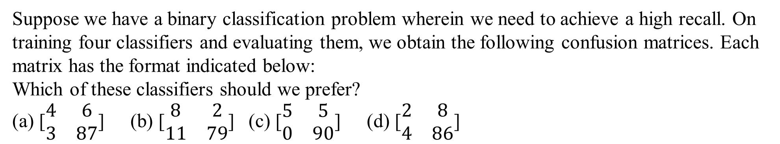
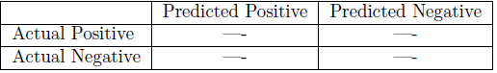
QUESTION 4
SOLUTION 4
The recall is computed as TP/TP+FN .
For option (b), recall = 8/8+2 = 0.8, which is the maximum among all the options. Similarly, we can compute it for the other options and verify that option (b) has the highest recall.
CORRECT ANSWER 4
b)

Slide 13
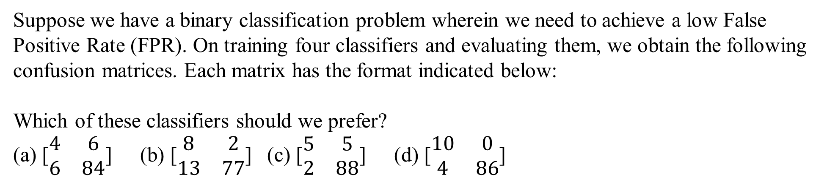
QUESTION 5
SOLUTION 5
The FPR is computed as FP/FP+TN .
For option (c), FPR = 2/88+2 = 0.022, which is the minimum among all the options. Similarly, we compute it for the other options and verify that option (c) has the lowest FPR.
CORRECT ANSWER 5
c)

Slide 14
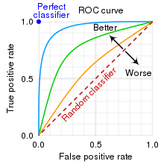
QUESTION 6
In a ROC curve, what does the diagonal line represent?
The perfect classifier
Random guessing
Trade-off between sensitivity and specificity
The ideal threshold for classification
SOLUTION 6
When AUC=0.5, then the classifier is not able to distinguish between Positive and Negative class points. Meaning that the classifier either predicts a random class or a constant class for all the data points.
CORRECT ANSWER 6
b)

Slide 15
QUESTION 7
Consider the following statements.
Statement P: Boosting takes multiple weak classifiers and combines them into a strong classifier.
Statement Q: Boosting assigns equal weights to the predictions of all the weak classifiers, resulting in a high overall performance.
(a) P is True. Q is True. Q is the correct explanation for A.
(b) P is True. Q is True. Q is not the correct explanation for A.
(c) P is True. Q is False.
(d) Both P and Q are False.
SOLUTION 7
Statement P is true since it summarizes the basic principle of boosting.
As explained in the lecture, boosting determines the proportion of importance each weak classifier should be assigned and combines them to make the final prediction. It does not assign equal weights to each classifier. Hence, statement Q is false.
CORRECT ANSWER 7
c)

Slide 16
QUESTION 8
Which of the following statement(s) about ensemble methods is/are correct?
a) The individual classifiers in bagging cannot be trained parallelly.
b) The individual classifiers in boosting cannot be trained parallelly.
c) A committee machine can consist of different kinds of classifiers like SVM, decision trees and logistic regression.
d) Bagging further increases the variance of an unstable classifier.
SOLUTION 8
The individual classifiers in bagging cannot be trained parallelly.
The individual classifiers in boosting cannot be trained parallelly. It is trained sequentially.
A committee machine can consist of different kinds of classifiers like SVM, decision trees and logistic regression.
Bagging further decreases the variance of an unstable classifier.
CORRECT ANSWER 8
b), c)

Slide 17
QUESTION 9
For the ROC curve of True positive rate vs False positive rate, which of the following are true?
a) The curve should always concave (negative convex).
b) The curve should never concave.
c) Concave ROC curve has AUC=0.5
d) Convex ROC curve has AUC=1
SOLUTION 9
The curve should never concave.
Concave ROC curve has 0<AUC<0.5
Convex ROC curve has 0.5<AUC<1
CORRECT ANSWER 9
b)

Slide 18
QUESTION 10
Sensitivity is same as:
Precision
Recall
Specificity
None of the above
SOLUTION 10
Sensitivity is same as Recall
CORRECT ANSWER 10
b)

